Slide 1
Autosomal structural rearrangements Deletions and Duplications

Slide 2
Mechanisms of formation of structural rearrangement
Recurrent rearrangements share essentially the same size and genomic content in unrelated individuals, the breakpoints being fixed by the presence of highly homologous long flanking repeats
Nonrecurrent rearrangements have a size and genomic content that is unique to the individual

Slide 3
Recurrent rearrangements
Nonallelic homologous recombination NAHR
Existence of multiple DNA sequences throughout the genome, which are sufficiently similar (paralogous) that they enable erroneous coming-together of different chromosome regions
“ectopic synapsis” sets the scene for a subsequent “ectopic
homologous recombination”
These similar sequences are called duplicons, segmental duplications, or low copy repeats

Slide 4
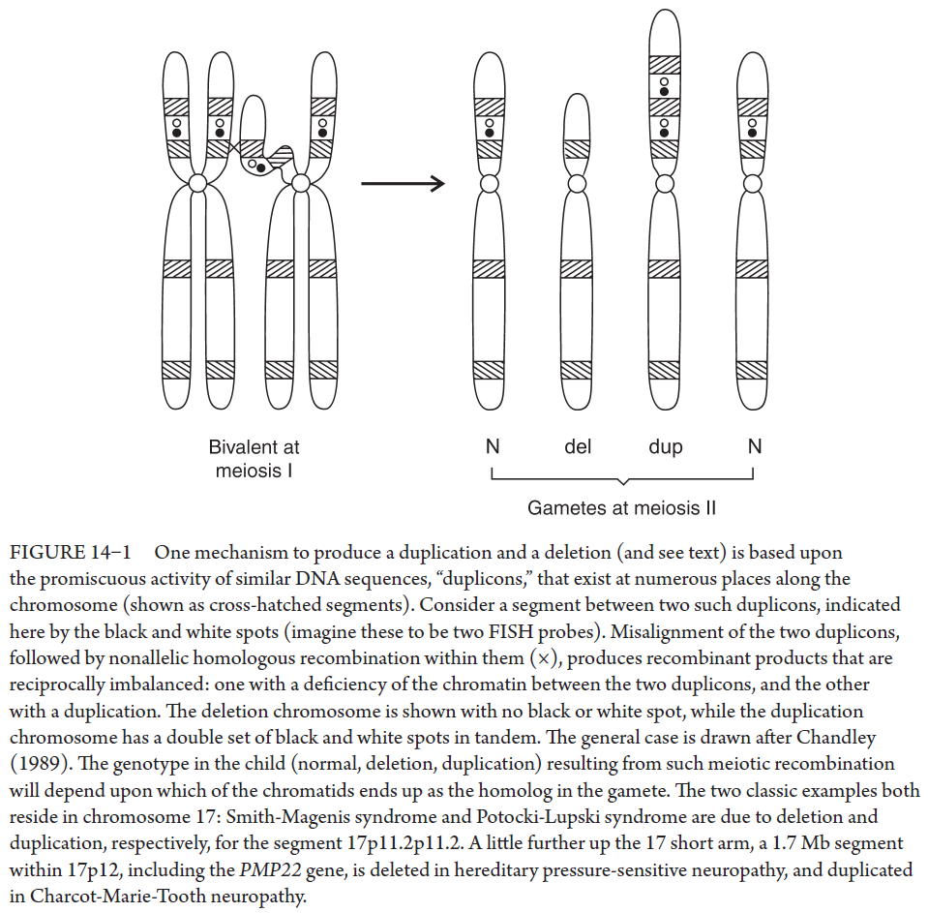

Slide 5
17p11.2
Deletion: Smith-Magenis syndrome
Duplication: Potocki-Lupski syndrome
17p12
Deletion: Hereditary pressure-sensitive neuropathy
Duplication: Charcot-Marie-Tooth neuropathy

Slide 6
Nonrecurrent rearrangements
Characterized by the widespread locations of breakpoints, leading to del/dups of unique size and genomic content
Absence of any sequence homology (“blunt ends”), is indicative of nonhomologous end joining (NHEJ)
During mitotic cell, different chromosomal segments may happen to be in close proximity, due to their “geographical space” within the nucleus may have predisposed to their coming together. If breaks occur during replication, instead of the correct ends being brought back together, the broken ends of different segments may inappropriately be ligated

Slide 7
Origin intra-, pre-, or post-meiosis
Recurrent de novo del/dup typically reflect an origin during meiosis >> risk of recurrence very low, because only the gamete from that particular meiosis carried the defect
Nonrecurrent, some of meiotic origin, without increased risk of recurrence, some originated in a premeiotic mitosis, gonadal mosaicism, there is a risk of passing imbalance
Rearrangement arising at a postzygotic mitosis, from an initially normal conceptus, leading to mosaicism, no increased risk of recurrence

Slide 8
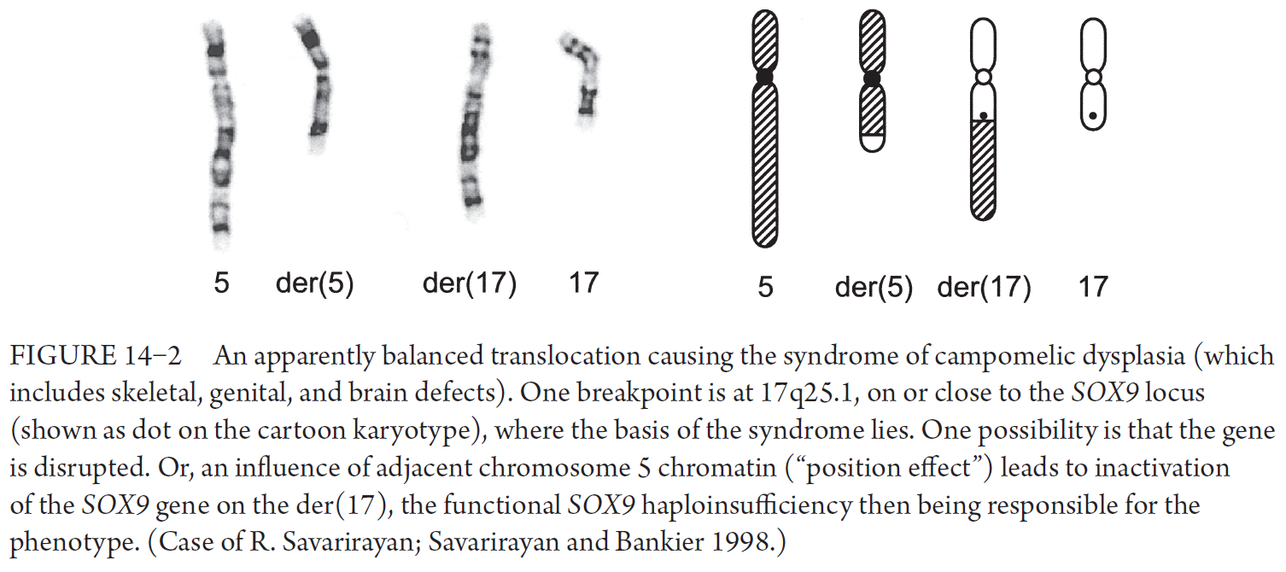
Apparently balanced but actually unbalanced rearrangement
Gene might be disrupted or affected by the new position

